Slide 1


BUSINESS
项目汇报
The user can demonstrate on a projector or computer, or print the presentation and make it into a in a wider field
汇报人：管理资源吧

Slide 2
01
02
03
04
CONTENTS
项目介绍
产品运营
发展规划
资本融资
The user can demonstrate on a projector or computer, or print the presentation and make it into a in a wider fieldThe user can demonstrate on a projector or computer, it into a in a wider field

Slide 3
01
项目
介绍
The user can demonstrate on a projector or computer, or print the presentation and make it into a in a wider field

Slide 4


01
项目介绍
The user can demonstrate on a projector or computer
标题文字添加
标题文字添加
The user can demonstrate on a projector or computer, or presentation and make it film to be used in a wider fieldThe user can demonstrate on a projector or computer, or presentation and make it film to be used in a wider field
The user can demonstrate on a projector or computer, or presentation and make it film to be used in a wider fieldThe user can demonstrate on a projector or computer, or presentation and make it film to be used in a wider field

Slide 5

01
项目介绍
The user can demonstrate on a projector or computer
The user can demonstrate on a projector or computer, or print the presentation and make it into a film to be used in a wider field. Using PowerPoint
The user can demonstrate on a projector or computer, or print the presentation and make it into a film to be used in a wider field. Using PowerPoint, not only can you create presentations, you can also hold face-to-face meetings, teleconferencing, or presentations on the Internet
The user can demonstrate on a projector or computer, or print the presentation and make it into a film to be used in a wider field. Using PowerPoint

Slide 6
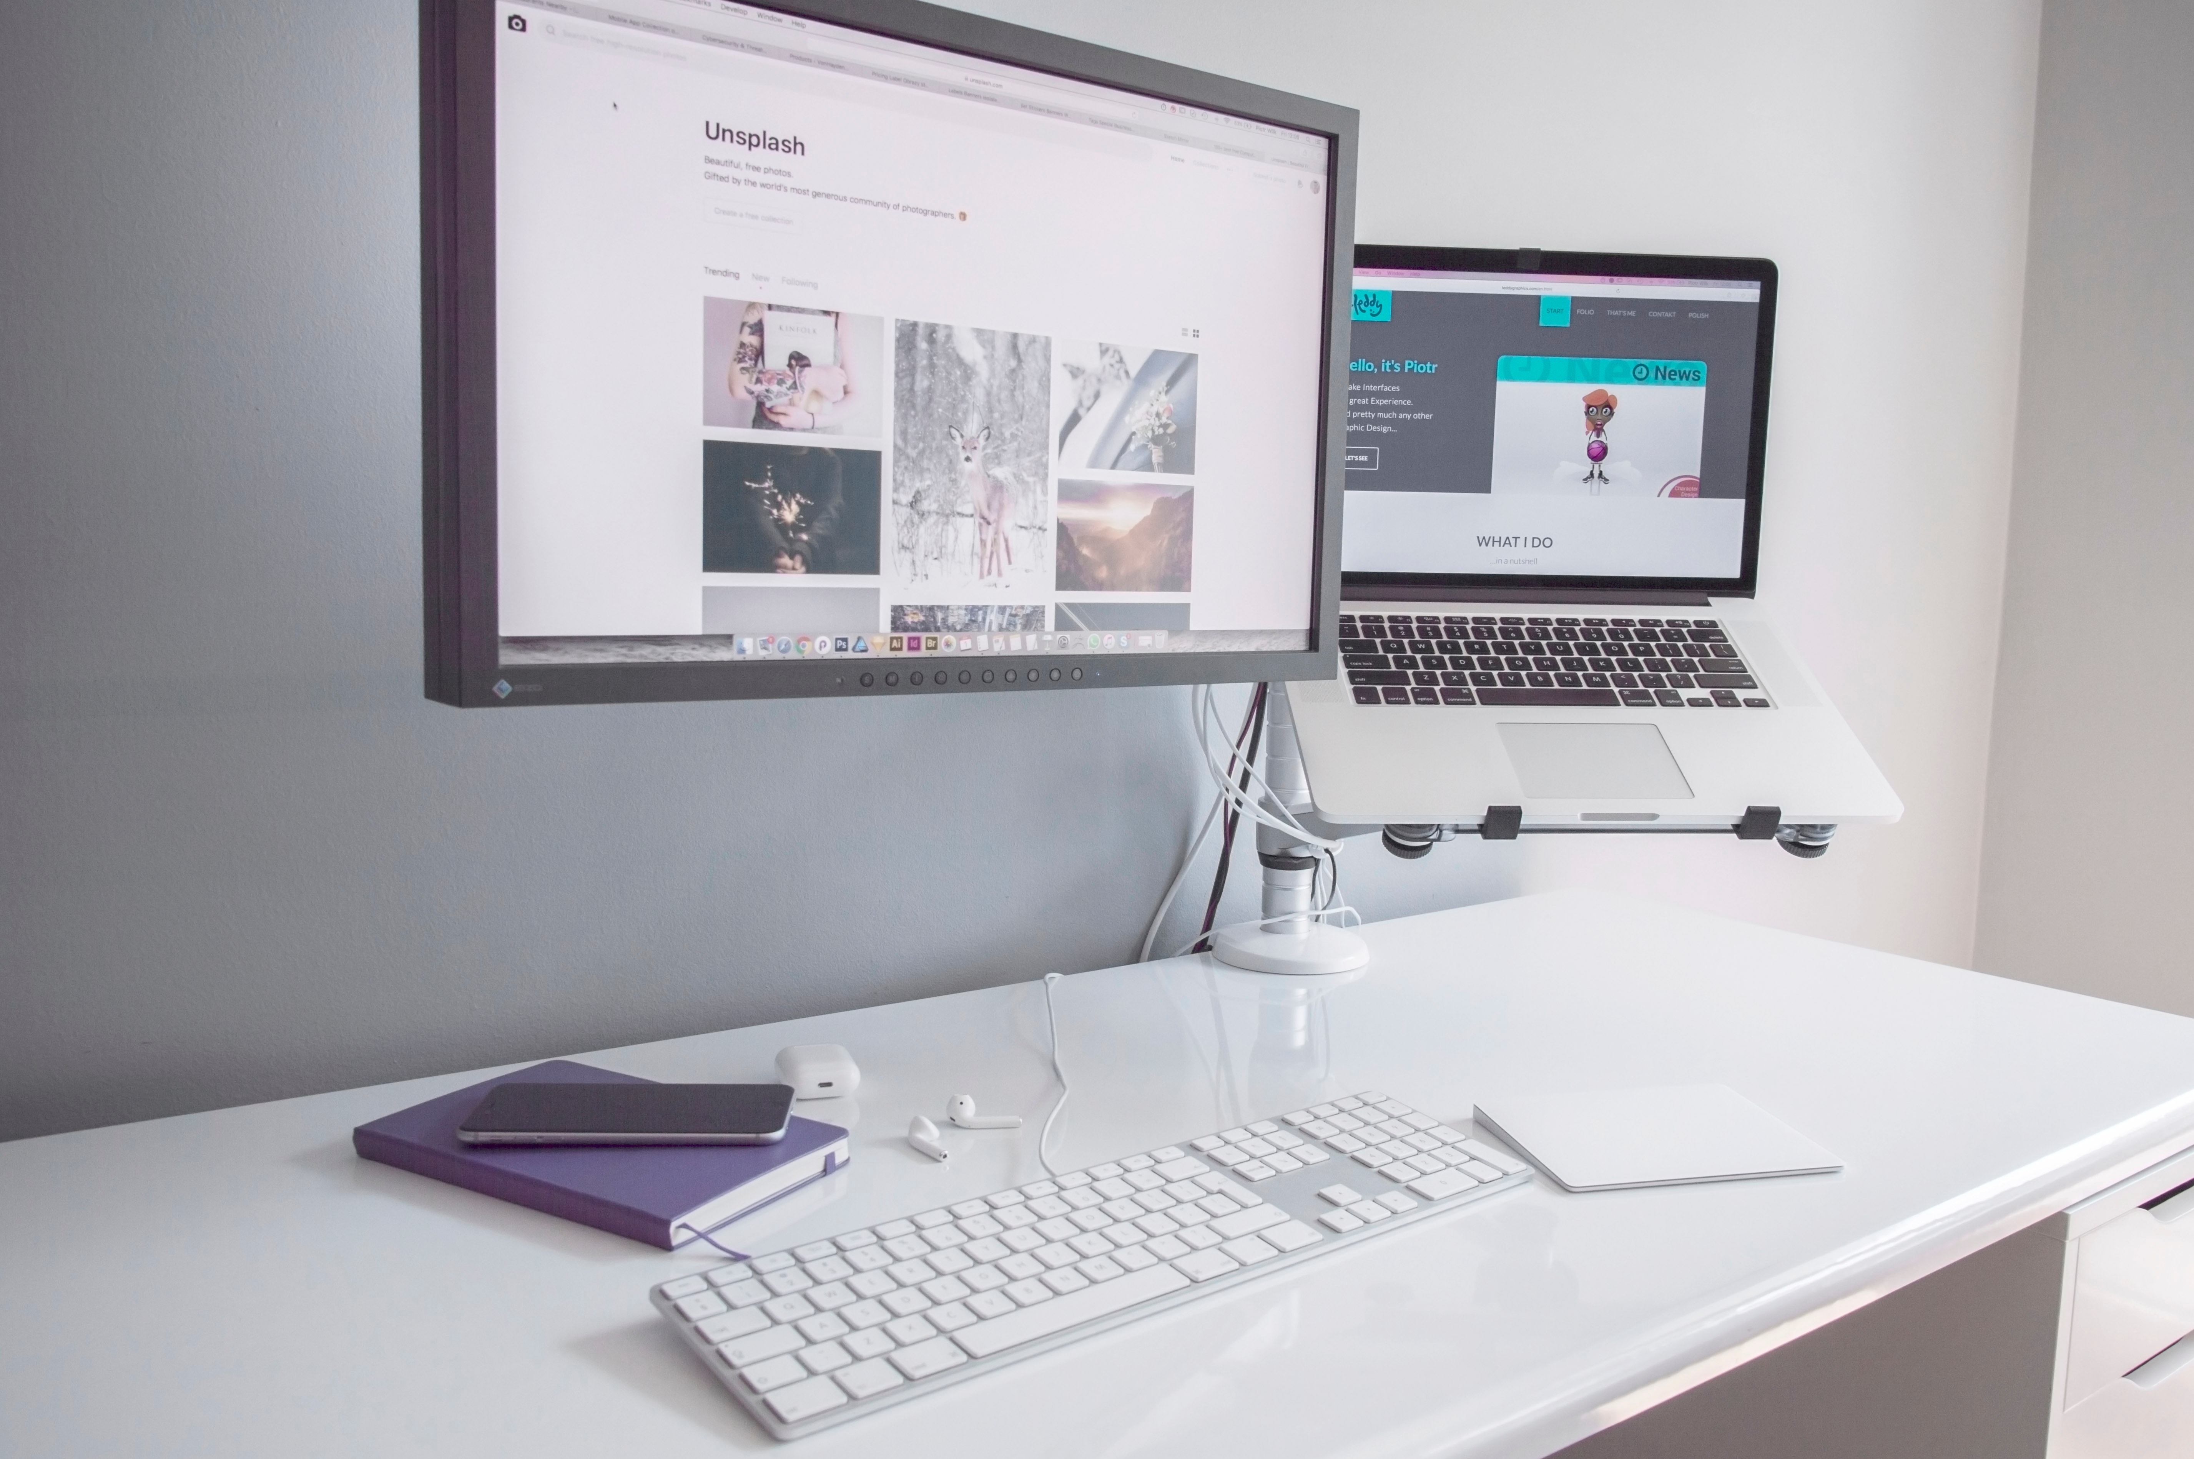


01
项目介绍
The user can demonstrate on a projector or computer
标题文字添加
标题文字添加
标题文字添加
The user can demonstrate on a projector or computer, or presentation and make it film to be used in a wider field
The user can demonstrate on a projector or computer, or presentation and make it film to be used in a wider field
The user can demonstrate on a projector or computer, or presentation and make it film to be used in a wider field

Slide 7
01
项目介绍
The user can demonstrate on a projector or computer
标题文字添加
标题文字添加
The user can demonstrate on a projector or computer, or print the presentation and make it into a film to be used in a wider field
The user can demonstrate on a projector or computer, or print the presentation and make it into a film to be used in a wider field
标题文字添加
标题文字添加
The user can demonstrate on a projector or computer, or print the presentation and make it into a film to be used in a wider field
The user can demonstrate on a projector or computer, or print the presentation and make it into a film to be used in a wider field

Slide 8
01
项目介绍
The user can demonstrate on a projector or computer
标题文字添加
标题文字添加
presentation and make it film to be used in a wider field
presentation and make it film to be used in a wider field
标题文字添加
标题文字添加
标题文字添加
presentation and make it film to be used in a wider field
presentation and make it film to be used in a wider field
presentation and make it film to be used in a wider field

Slide 9
02
产品
运营
The user can demonstrate on a projector or computer, or print the presentation and make it into a in a wider field

Slide 10

02
产品运营
The user can demonstrate on a projector or computer
标题文字添加
标题文本预设
标题文本预设
标题文字添加
The user can demonstrate on a projector or computer, or presentation and make it film to be used in a wider field
The user can demonstrate on a projector or computer, or presentation and make it film to be used in a wider field
标题文字添加
标题文字添加
The user can demonstrate on a projector or computer, or presentation and make it film to be used in a wider field
The user can demonstrate on a projector or computer, or presentation and make it film to be used in a wider field
标题文本预设
标题文本预设

Slide 11




02
产品运营
The user can demonstrate on a projector or computer
标题文字添加
标题文字添加
标题文字添加
标题文字添加
The user can demonstrate on a projector or computer
The user can demonstrate on a projector or computer
The user can demonstrate on a projector or computer
The user can demonstrate on a projector or computer
标题文字添加
标题文字添加
标题文字添加
标题文字添加
The user can demonstrate on a projector or computer
The user can demonstrate on a projector or computer
The user can demonstrate on a projector or computer
The user can demonstrate on a projector or computer

Slide 12
02
产品运营
The user can demonstrate on a projector or computer
Supporting text here
44%
Supporting text here
78%
Supporting text here
89%
Supporting text here
75%
Supporting text here
78%

Slide 13



02
产品运营
The user can demonstrate on a projector or computer
标题文字添加
标题文字添加
标题文字添加
The user can demonstrate on a projector or computer
The user can demonstrate on a projector or computer
The user can demonstrate on a projector or computer

Slide 14

02
产品运营
The user can demonstrate on a projector or computer
BUSINESS BROCHURE
用户可以在投影仪或者计算机上进行演示，也可以将演示文稿打印出来，制作成胶片

Slide 15
03
发展
规划
The user can demonstrate on a projector or computer, or print the presentation and make it into a in a wider field

Slide 16

03
发展规划
The user can demonstrate on a projector or computer
标题文字添加
The user can demonstrate on a projector or computer, or print the presentation and make it into a film to be used in a wider field. Using PowerPoint,
标题文字添加
The user can demonstrate on a projector or computer, or print the presentation and make it into a film to be used in a wider field. Using PowerPoint,
标题文字添加
The user can demonstrate on a projector or computer, or print the presentation and make it into a film to be used in a wider field. Using PowerPoint,

Slide 17
03
发展规划
The user can demonstrate on a projector or computer
标题文字添加
The user can demonstrate on a projector or computer, or presentation and make it film to be used in a wider field
关 键词
标题文字添加
关键词
The user can demonstrate on a projector or computer, or presentation and make it film to be used in a wider field
标题文字添加
关键词
The user can demonstrate on a projector or computer, or presentation and make it film to be used in a wider field
标题文字添加
关键词
The user can demonstrate on a projector or computer, or presentation and make it film to be used in a wider field

Slide 18
03
发展规划
The user can demonstrate on a projector or computer
2018
标题文字添加
2017
The user can demonstrate on a projector or computer, or print the presentation and make it into a film to be used
标题文字添加
2016
The user can demonstrate on a projector or computer, or print the presentation and make it into a film to be used
标题文字添加
2015
The user can demonstrate on a projector or computer, or print the presentation and make it into a film to be used
标题文字添加
The user can demonstrate on a projector or computer, or print the presentation and make it into a film to be used

Slide 19
03
发展规划
The user can demonstrate on a projector or computer
The user can demonstrate on a projector or computer, or print the presentation and make it into a film to be used in a wider field. Using PowerPoint, The user can demonstrate on a projector or computer, or print the presentation and make it into a film to be used in a wider field. Using PowerPoint, The user can demonstrate on a projector or computer, or print the presentation and make it into a film to be used in a wider field. Using PowerPoint, The user can demonstrate on a projector or computer, or print the presentation
标题文字添加
标题文字添加
标题文字添加
标题文字添加
标题文字添加
标题文字添加
标题文字添加
标题文字添加
标题文字添加
标题文字添加
标题文字添加
标题文字添加

Slide 20
04
资本
融资
The user can demonstrate on a projector or computer, or print the presentation and make it into a in a wider field

Slide 21
04
资本融资
The user can demonstrate on a projector or computer
标题文字添加
标题文字添加
The user can demonstrate on a projector or computer, or print the presentation and make it into a film to be used in a wider field
The user can demonstrate on a projector or computer, or print the presentation and make it into a film to be used in a wider field
01
03
02
标题文字添加
The user can demonstrate on a projector or computer, or print the presentation and make it into a film to be used in a wider field

Slide 22

04
资本融资
The user can demonstrate on a projector or computer
标题文字添加
标题文字添加
标题文字添加
The user can demonstrate on a projector or computer, or print the presentation and make it into a film to be used in a wider field. Using PowerPoint,
The user can demonstrate on a projector or computer, or print the presentation and make it into a film to be used in a wider field. Using PowerPoint,
The user can demonstrate on a projector or computer, or print the presentation and make it into a film to be used in a wider field. Using PowerPoint,

Slide 23
04
资本融资
The user can demonstrate on a projector or computer
标题文字添加
The user can demonstrate on a projector or computer, or print the presentation and make it into a film to be used in a wider field. Using PowerPoint,
标题文字添加
The user can demonstrate on a projector or computer, or print the presentation and make it into a film to be used in a wider field. Using PowerPoint,
标题文字添加
标题文字添加
The user can demonstrate on a projector or computer, or print the presentation and make it into a film to be used in a wider field. Using PowerPoint,

Slide 24
04
资本融资
The user can demonstrate on a projector or computer
标题文字添加
标题文字添加
标题文字添加
标题文字添加
The user can demonstrate on a projector or computer, or presentation and make it film to be used in a wider field
The user can demonstrate on a projector or computer, or presentation and make it film to be used in a wider field
The user can demonstrate on a projector or computer, or presentation and make it film to be used in a wider field
The user can demonstrate on a projector or computer, or presentation and make it film to be used in a wider field

Slide 25
BUSINESS
谢谢观看
The user can demonstrate on a projector or computer, or print the presentation and make it into a in a wider field
汇报人：管理资源吧

